Slide 1



Current London 2025
Processing Exception Handling and Dead Letter Queue in Kafka Streams
Sébastien Viale
Loïc Greffier

Slide 2

Key Takeaways
🧠 Better Understanding of Processing Exceptions
🛠️ Latest Updates in Error Handling (KIP-1033)
📬 Native DLQ Support (KIP-1034)
💻 Configuration and Code Examples Included

Slide 3


About Us
Sébastien Viale
Loïc Greffier
Software Engineer
@ Michelin
Software Engineer
@ Michelin

Slide 4














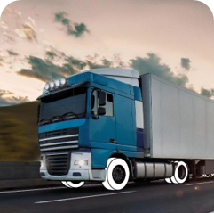



About Michelin
6600 Topics
24000 Partitions
260 Namespaces
3 MB/s ↗️
20 MB/s ↙️

Slide 5
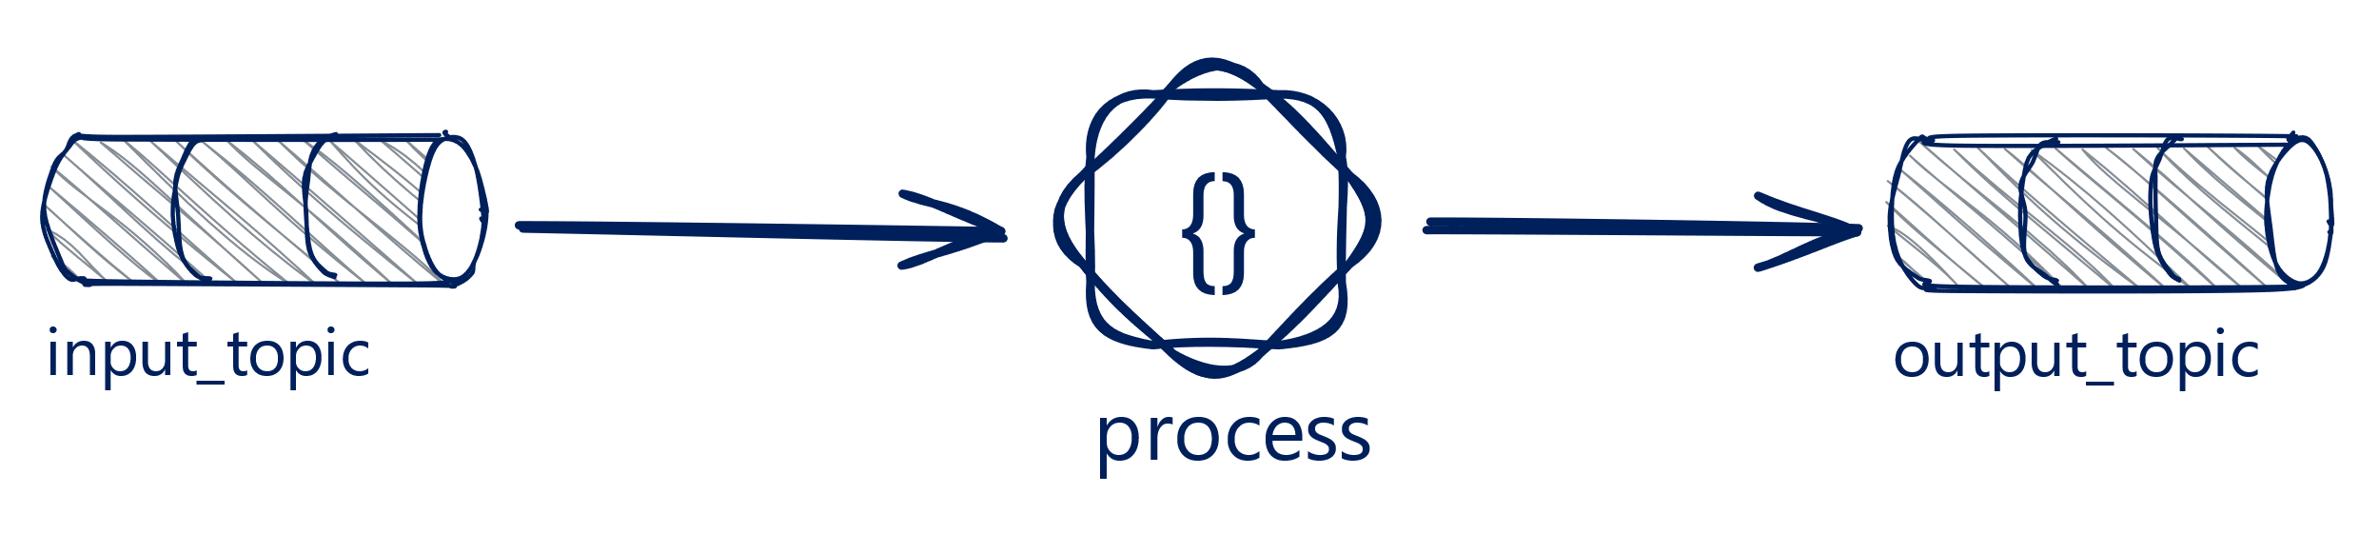
What Are Processing Exceptions
« In » Errors
« Out » Errors
« Right in the middle »
Errors

Slide 6
What Are Processing Exceptions
Implemented logic fails to process events
💥
❌
Can be unrecoverable
Technical or business reasons
🧠

Slide 7


What Are Processing Exceptions
NullPointerException:
value.getNumberOfTires() >= 10
DeliveryBooked
{
"deliveryId": "DEL12345",
"truckId": "TRK56789",
"numberOfTires": 18,
"destination": "Paris"
}
throw new InvalidDeliveryException()

Slide 8
Handling Processing Errors
KafkaStreams kafkaStreams = new KafkaStreams(topology, properties);
kafkaStreams.setUncaughtExceptionHandler(exception ->
SHUTDOWN_CLIENT);
kafkaStreams.start();

Slide 9
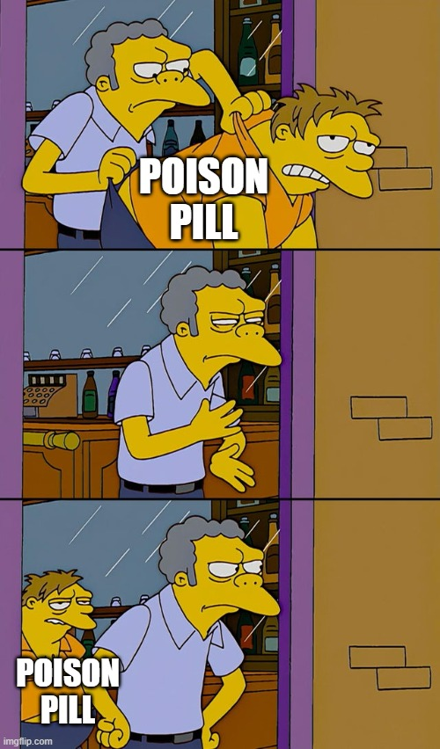
Handling Processing Errors
Log and interrupt processing
⛔
Cannot skip compromised records
🧨
🧩
Lack of inputs

Slide 10
Handling Processing Errors
streamsBuilder.stream("input_topic")
.mapValues(value -> {
try {
return parseFromJson(value);
} catch (Exception e) {
log.error("Error parsing value {}", value, e);
return null;
}
})
.filter((key, value) -> {
try {
return value.getNumberOfTires() >= 10;
} catch (Exception e) {
log.error("Error filtering value {}", value, e);
return false;
}
})
.to("output_topic");

Slide 11
Handling Processing Errors
public class CustomProcessor extends ContextualProcessor<> {
@Override
public void process(Record<String, String> record) {
try {
DeliveryBooked value = parseFromJson(record.value());
if (value.getNumberOfTires() >= 10) {
context().forward(record.withValue(parseToJson(value)));
}
} catch (Exception e) {
log.error("Error processing record: {}", record, e);
}
}
}

Slide 12
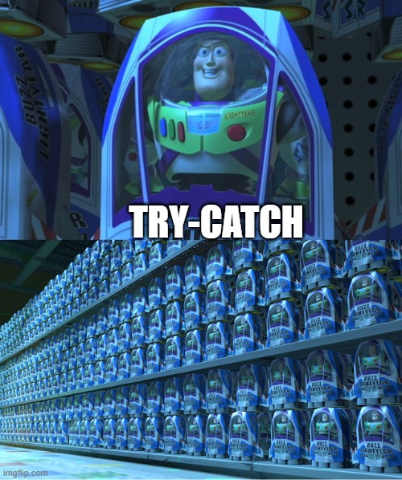
Handling Processing Errors
🤹‍♂️
Try-catch everywhere
Hard to:
Read
Maintain
Evolve
Monitor
🧱

Slide 13
Processing Exception Handler
(KIP-1033)

Slide 14
Processing Exception Handler (KIP-1033)
🚀
Enhances processing error-handling mechanism
Inspired by Deserialization and Production error handling
💡
🧰
New handler ProcessingExceptionHandler
📦
Available since Apache Kafka 3.9.0

Slide 15
Processing Exception Handler (KIP-1033)
New property processing.exception.handler and interface
public interface ProcessingExceptionHandler extends Configurable { ProcessingHandlerResponse handle(
final ErrorHandlerContext context,
final Record<?, ?> record,
final Exception exception);
public static enum ProcessingHandlerResponse { CONTINUE(1, "CONTINUE"),
FAIL(2, "FAIL");
}
}

Slide 16
Processing Exception Handler (KIP-1033)
ErrorHandlerContext context
Give access to topic, partition, offset, headers, timestamp, processor ID and task ID
🔍
DeserializationExceptionHandler and ProductionExceptionHandler
updated for consistency
⚡

Slide 17
Processing Exception Handler (KIP-1033)
Record<?,?> record
Input record of the processor that raised the exception
🎯
.stream()
.filter()
.flatMapValues() ← Exception
.to()
🃏
Wildcard-type
⏱️
Null if exception is raised from punctuation

Slide 18
Processing Exception Handler (KIP-1033)
Exception exception
⚠️
The processing exception itself
Implement handling logic based on the exception type
🧠

Slide 19

Processing Exception Handler (KIP-1033)
LogAndFailProcessingExceptionHandler (Default): Logs the exception and fails the stream
LogAndContinueProcessingExceptionHandler: Logs the exception and continues processing the next records

Slide 20
Processing Exception Handler (KIP-1033)
processing.exception.handler=com.example.CustomProcessingHandler
@Override
public ProcessingHandlerResponse handle(ErrorHandlerContext context, Record<?, ?> record,
Exception exception) {
if (exception instanceof JsonSyntaxException)
return ProcessingHandlerResponse.FAIL;
if (exception instanceof InvalidDeliveryException)
return ProcessingHandlerResponse.CONTINUE;
if (exception instanceof NetworkException)
return ProcessingHandlerResponse.FAIL;
return ProcessingHandlerResponse.CONTINUE;
}

Slide 21
Processing Exception Handler (KIP-1033)
processing.exception.handler=com.example.CustomProcessingHandler
@Override
public ProcessingHandlerResponse handle(ErrorHandlerContext context, Record<?, ?> record,
Exception exception) {
if (record.value() instanceof DeliveryBooked deliveryBooked) {
return deliveryBooked.getNumberOfTires() == null ? ProcessingHandlerResponse.CONTINUE : ProcessingHandlerResponse.FAIL;
}
return ProcessingHandlerResponse.CONTINUE;
}

Slide 22
Processing Exception Handler (KIP-1033)
Metrics:
Dropped-record-total: The total number of dropped records
Dropped-record-rate: The average number of dropped records per second
Updated when ProcessingExceptionHandler is set to CONTINUE

Slide 23
Dead Letter Queue
(KIP-1034)

Slide 24
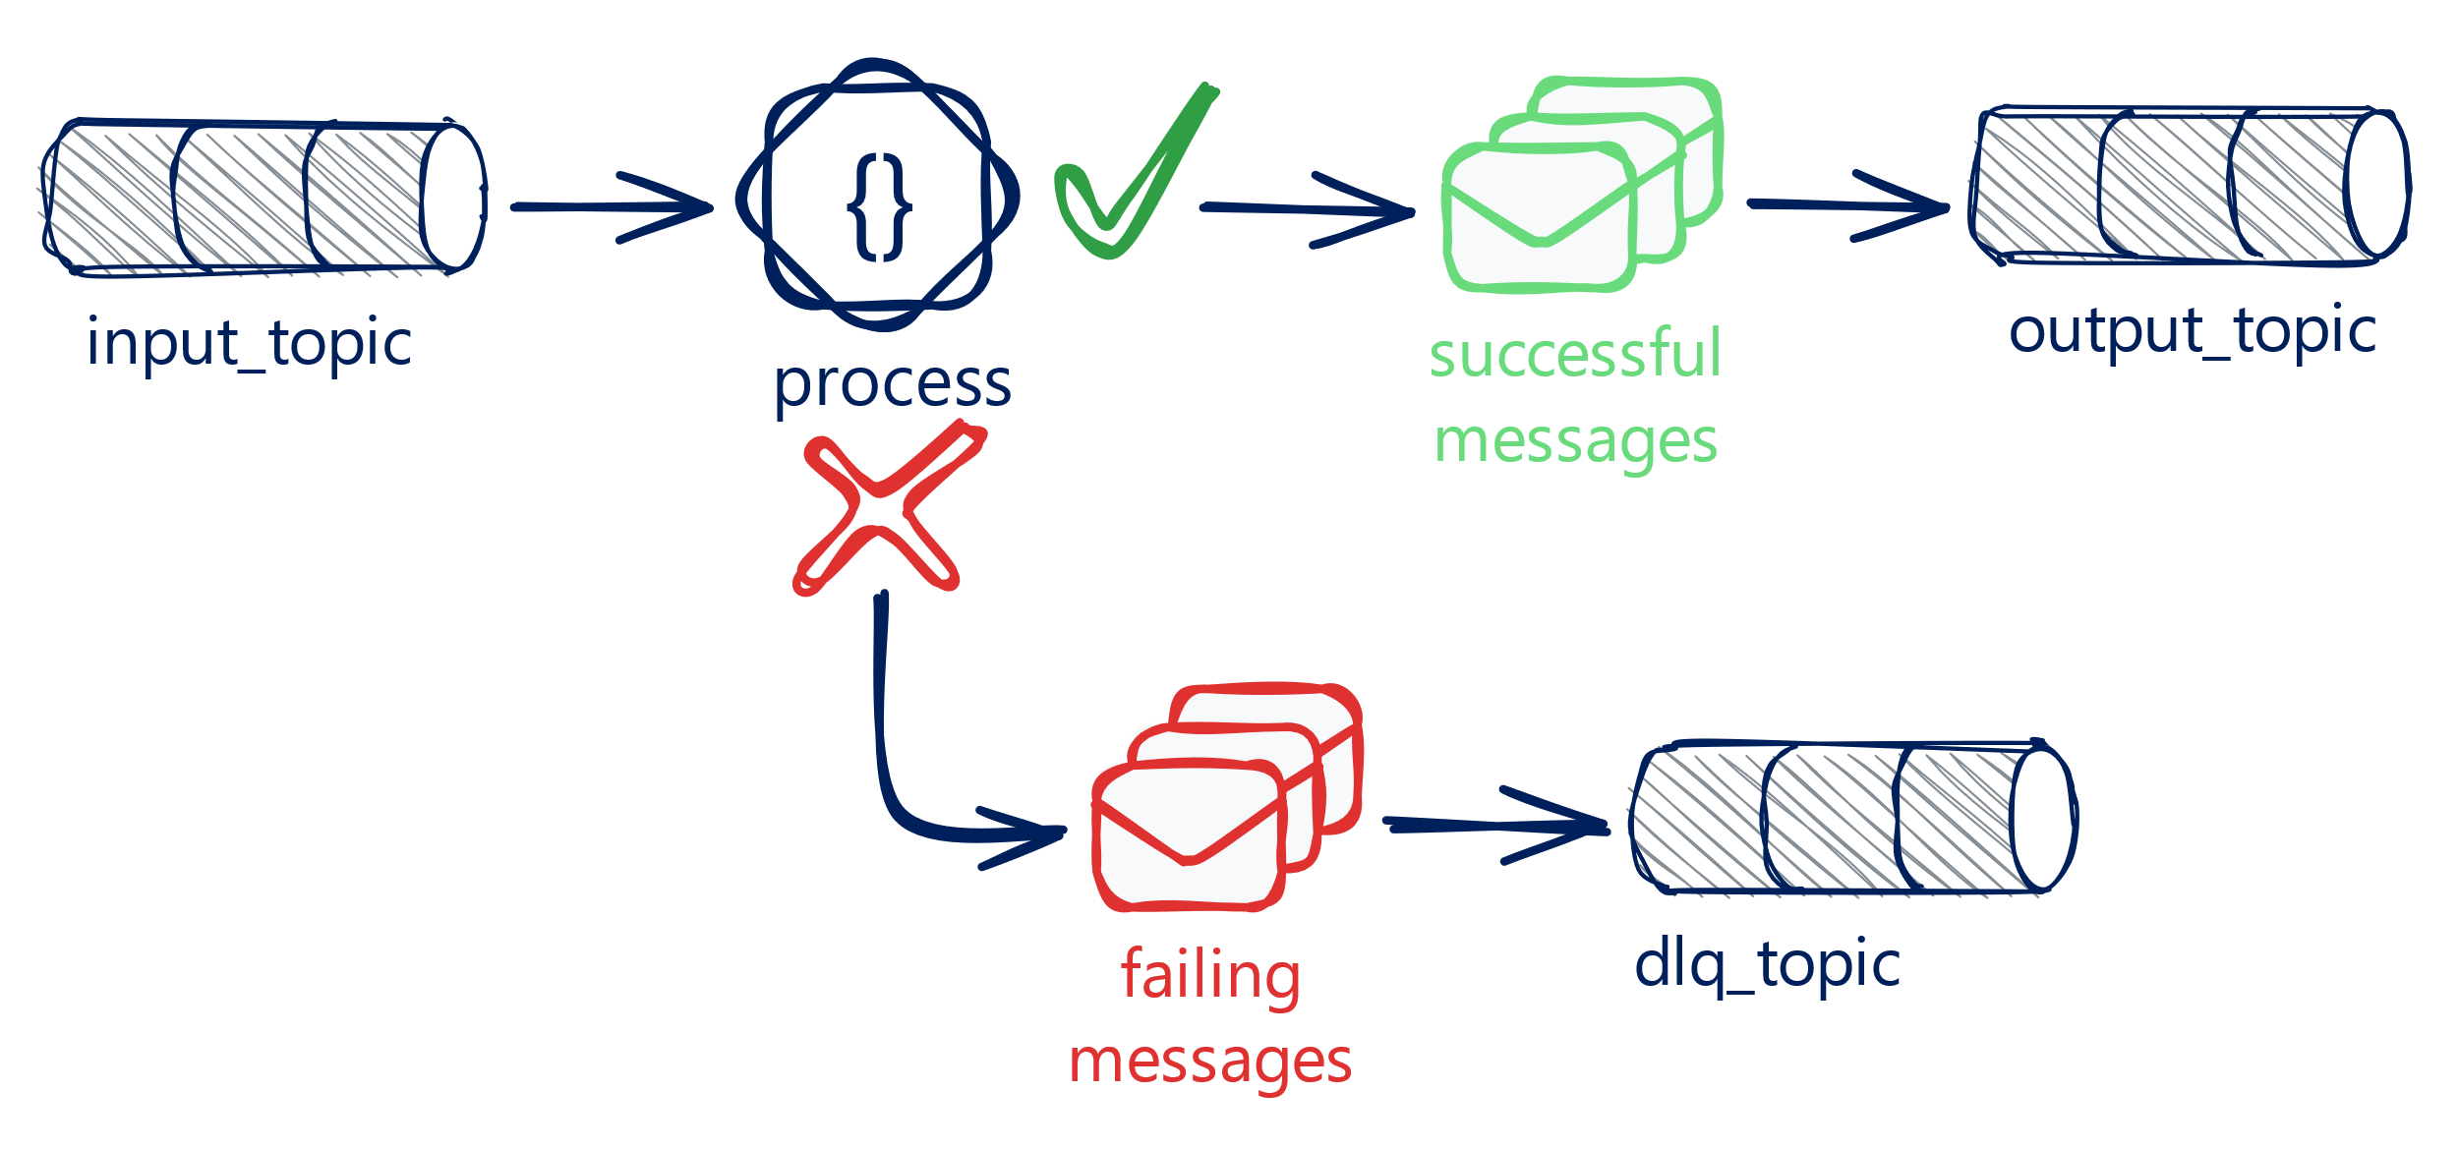
Dead Letter Queue (KIP-1034)
A dedicated Kafka topic to send failing messages
Need a handling logic and routing logic (e.g., split)
🚀 Benefits:
Fault tolerance
Data integrity
Monitoring

Slide 25
Dead Letter Queue (KIP-1034)
Routing to a DLQ topic using branches
streamsBuilder.stream("input_topic")
.mapValues(value -> {
try {
return parseFromJson(value);
} catch (Exception e) {
log.error("Error parsing value {}", value, e);
return null;
}
})
.split()
.branch((key, value) -> value != null, Branched.as("success"))
.defaultBranch(Branched.withConsumer(stream -> forwardToDLQ(stream)))
.get("success")
...

Slide 26
Dead Letter Queue (KIP-1034)
Routing to a DLQ topic using a producer in handlers
@Override
public ProcessingHandlerResponse handle(ErrorHandlerContext context, Record<?, ?> record,
Exception exception) {
if (record.value() instanceof DeliveryBooked deliveryBooked) {
ProducerRecord<String, DeliveryBooked> producerRecord = new ProducerRecord<>("dlq_topic",
(String) record.key(),
deliveryBooked);
producer.send(producerRecord);
}
return ProcessingHandlerResponse.CONTINUE;
}

Slide 27
Dead Letter Queue (KIP-1034)
🚀
Add native DLQ routing mechanism
♻️
Reusable by all exception handlers
🧾
Identify source raw record for replayability
✅
Voted; implementation in progress

Slide 28
Dead Letter Queue (KIP-1034)
Old handle method is deprecated
public interface ProcessingExceptionHandler extends Configurable {
@Deprecated
default ProcessingHandlerResponse handle(
final ErrorHandlerContext context,
final Record<?, ?> record,
final Exception exception) { ... }
}

Slide 29
Dead Letter Queue (KIP-1034)
New handleError method
public interface ProcessingExceptionHandler extends Configurable {
default Response handleError(
final ErrorHandlerContext context,
final Record<?, ?> record,
final Exception exception) {
return new Response(...);
}
}

Slide 30
Dead Letter Queue (KIP-1034)
New return type
class Response {
private Result result;
private List<ProducerRecord<byte[], byte[]>> deadLetterQueueRecords;
}
New decision statement
enum Result {
RESUME(1, "RESUME"),
FAIL(2, "FAIL");
}

Slide 31
Dead Letter Queue (KIP-1034)
public interface ErrorHandlerContext {
byte[] sourceRawKey();
byte[] sourceRawValue();
}
.stream() ← Source raw record
.selectKey()
.mapValues() ← Exception
.to()
.stream()
.groupBy()
.aggregate() ← Source raw record
.mapValues() ← Exception
.to()

Slide 32

Dead Letter Queue (KIP-1034)
LogAndFailProcessingExceptionHandler:
return Response.fail(records)
LogAndContinueProcessingExceptionHandler:
return Response.resume(records)

Slide 33
Dead Letter Queue (KIP-1034)
For the default topic
⚙️
New configuration: errors.deadletterqueue.topic.name
Used as default DLQ topic by provided handlers only
DLQ send is skipped if unset
Unused by custom handlers
📌
🚷
🚫

Slide 34
Dead Letter Queue (KIP-1034)
For the default record
🧷
Use the source raw key and source raw value
📨
Enriched with headers
_ _streams.errors.exception
_ _streams.errors.stacktrace
_ _streams.errors.message
_ _streams.errors.topic
_ _streams.errors.partition
_ _streams.errors.offset

Slide 35
Dead Letter Queue (KIP-1034)
processing.exception.handler=com.example.CustomProcessingHandler
@Override
public Response handleError(ErrorHandlerContext context, Record<?, ?> record,
Exception exception) {
if (exception instanceof JsonSyntaxException)
return Response.fail(List.of(new ProducerRecord<>("json_error_dlq_topic", context.sourceRawKey(), context.sourceRawValue())));
if (exception instanceof InvalidDeliveryException)
return Response.resume(List.of(new ProducerRecord<>("delivery_dlq_topic", context.sourceRawKey(), context.sourceRawValue())));
return Response.fail(List.of(new ProducerRecord<>("default_dlq_topic", context.sourceRawKey(), context.sourceRawValue())));
}

Slide 36
Key Takeaways
🧠 Better Understanding of Processing Exceptions
🛠️ Latest Updates in Error Handling (KIP-1033)
📬 Native DLQ Support (KIP-1034)
💻 Configuration and Code Examples Included

Slide 37



Thank you
Links
Slides and Code Sample
Credits
Diagrams made with Kafka Streams Topology Design (KSTD)
Michelin IT Engineering Blog

